Slide 1
PRODIGY
Power UP your Grammar
Academic Instructor
Dr. Meirav Taieb-Maimon
By Guy Manzurola
Notes:
Prodigy is a game based learning tool for English grammar

Slide 2
Prodigy is a Game Based E-Learning Tool
What is E-Learning?
Study anytime, at your own pace.
Delivered through digital devices (computer, mobiles etc.)
Cost-effective (no humans involved in teaching, provides automatic feedback)
Accessible

Slide 3
Goal
Create a playful environment for practicing multiple choice English grammar questions.
Keep Players (Students) Coming Back !

Slide 4
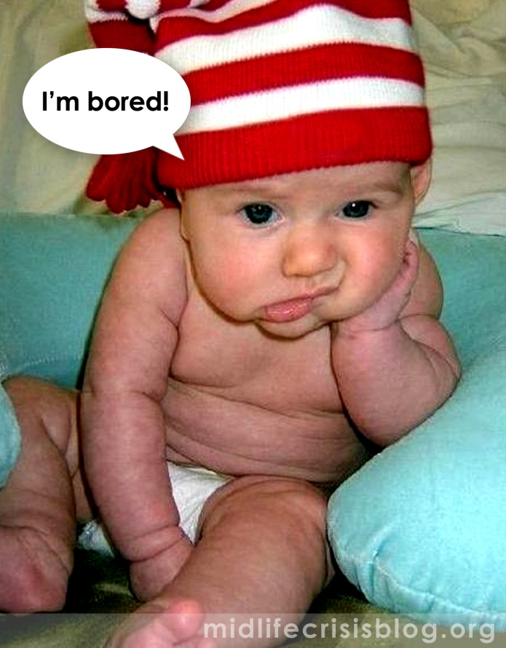
The Problem: Keeping Learners Motivated
It has always been one of the teacher’s primary roles to motivate students through the learning process.
Motives of a student:
Connection with the learnt
material (rare)
Extrinsic rewards
Intrinsic goals
Fear
Pleasing others
(Prensky, 2002)
Notes:
Problem:
Educators are mainly concerned with getting the material across, to instruct.
Motivation relies on:
-connection with the learnt material (rare)
-extrinsic rewards (get score over x, I’ll buy you a Lego set)
-Intrinsic goals (I want to be able to do Y, so I learn more)
-Fear (If I don’t do it, Z will happen)
-Pleasing others (Teacher will like me if I do this)

Slide 5
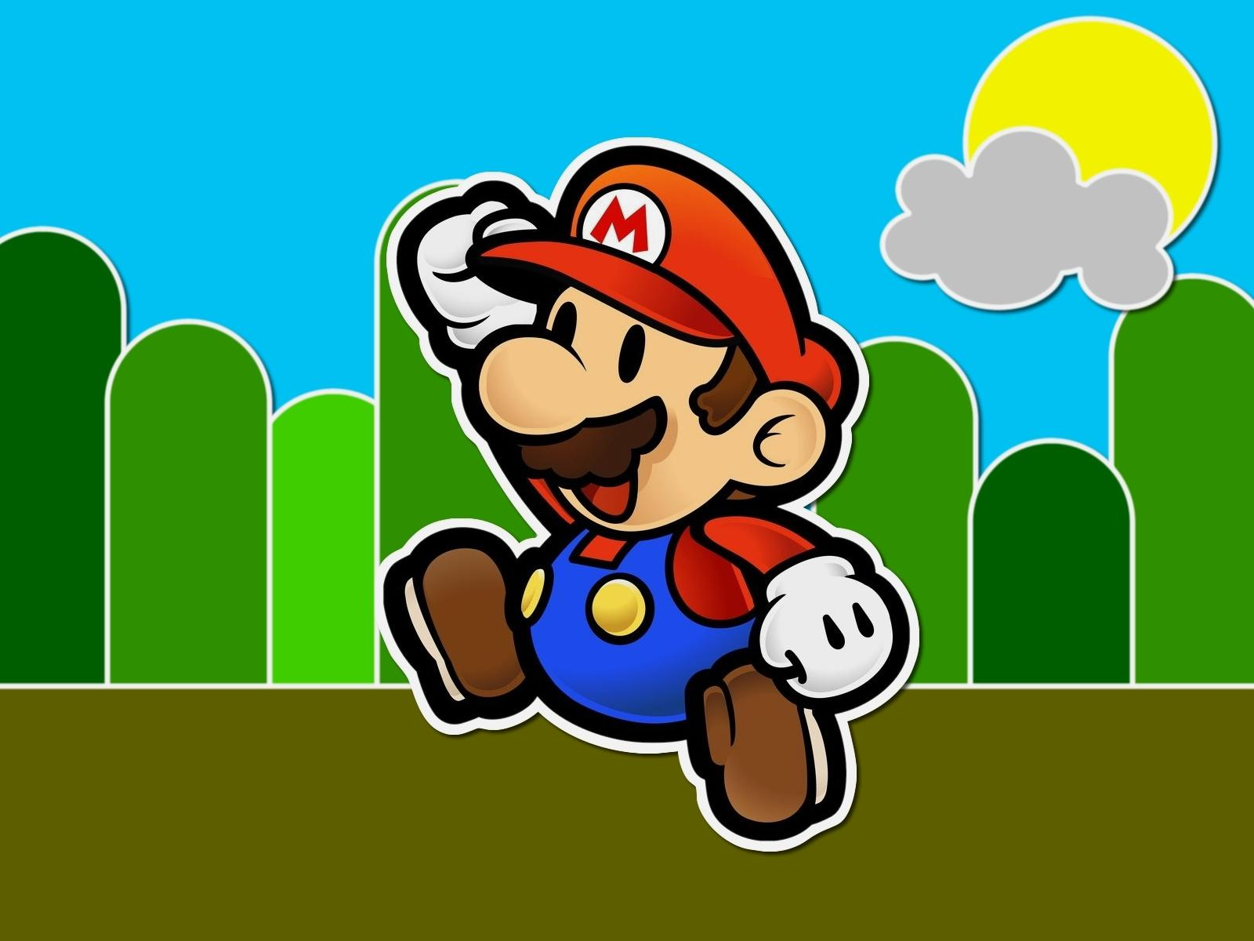
What Makes Things Fun To Learn?
Characteristics of a Good Game (Malone, 1980):
Challenge
Goals (performance feedback)
Uncertain Outcomes (multiple level goals, variable difficulty levels, hidden information, randomness)
Self Esteem (keep it high)
Fantasy
Extrinsic Fantasy
Intrinsic Fantasy
Curiosity
Sensory (sound and graphics)
Cognitive (surprising and constructive feedback)
Examples: Street Fighter X Tekken, New Super Mario Bros, Devil May Cry 5
Notes:
Learning and games:
Implement a learning tool using principles from game design.

Slide 6


Slide 7
Typical Multi-Choice Question
I ___ on a chair and ___ a banana!
Blank
Blank
Choices:
Choices:
seating
am seating
seat
seats
having
am eating
eating

Slide 8
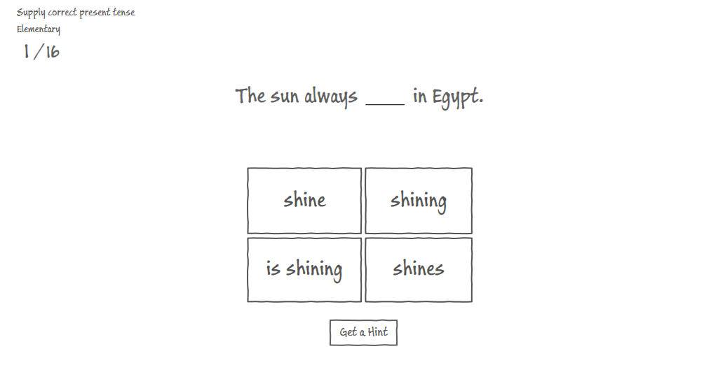
1st Iteration Screenshot
submit
Exists everywhere - http://www.englishexercises.org/makeagame/viewgame.asp?id=9257
Working Example - http://localhost:8080/game_lines.html

Slide 9
1st Iteration Design
Use case
Questions appear one at a time.
User selects a blank and matching answers appears
User fills all blanks and clicks submit
Solution is checked – false – receive hint, try again. Correct, can move to next question.
Problems
Submit button – removes the immediate feedback (Malone 1980).
Limited choices.
Lacking “character”.

Slide 10
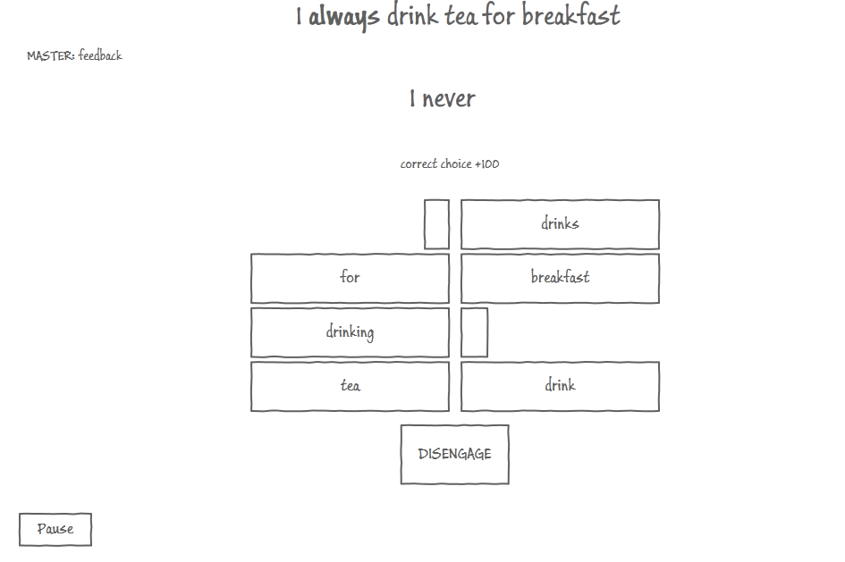
2nd iteration screen shot

Slide 11
2nd Iteration design
Larger amount of choices – introduces more interesting choices.
Overall better design – unique, adds character.
Problem: exercise still lacks character of a Level –Player curiosity is lost.

Slide 12
3rd Iteration – final
Score (multiple level goals)
Players play to achieve a top score
Combo (multiple level goals)
Players are rewarded more points when answering correctly consecutively
Health (challenge)
Mistakes decrement limited Health – players try no to die
Time (multiple level goals)
Players play against the clock and are rewarded on faster performance
Sensory Curiosity
Different animations on correct and false moves
Different feedback on correct moves
Hints granted on false answers
Challenge
More choices – unconventional.
Working alpha - http://localhost:8080/ -- mind you that Prodigy is still in early development.

Slide 13
Problems Encountered
Weakly defined requirements – Wishful thinking..
Defining Inputs / Outputs
Adding unnecessary complexity
Gold plating – Ego / Difficulty in focusing on one specific aspect.
Too much design and new ideas – hard to focus.
New Technologies – Java Servlets, Tomcat, HTML5, CSS3, JavaScript, jQuery.
Managing the construction of a web application without MVC (etc.) web frameworks (JSF, ASP..)

Slide 14
Problems Encountered (cont.)
Separation of concerns:
Client / Server
Screens
Game Engine Entities

Slide 15
Architecture
HTML5
(JavaScript, CSS3)
Solutions
Top Tier
Client
AJAX
JSON
HTTP GET
REST
Tomcat 7
REST Resources
Model Entities
Middle Tier
Server
Hibernate ORM
Hibernate
Tomcat Managed Connection Pooling
MySQL Database
Bottom Tier
Database

Slide 16
Solutions (cont.)
Had to accept the fact that concepts must be tested before fully implemented. Implementation of the first few concepts eventually led to the current one after testing and playing around with them.
Instructor helped narrow down the scope of the project - helped focus on a well defined set of features.
New technologies – play around and learn.

Slide 17
Solutions (cont. some more)
Separation of concerns
Client / Server: REST Architecture (HATEOAS)
Client uses links provided in responses to access additional resources – start with a single entry point
Screens: separate functionality to JS modules. Integrate using jQuery ‘load()’ and history API
Game Entities: OO JS – familiar grounds. First used jQuery – built a number of plugins, but eventually reverted back to JS – better performance and more “ego friendly”…

Slide 18
Lessons Learned
Proof of concept is crucial. Start prototype coding as soon as possible (in this situation)
When user experience is the goal – (as is in games) test and test again to get a concrete feeling
Develop and focus on one feature at a time
Code for testing – think about what you want to happen and how you will check it immediately after you code the functionality.

Slide 19
Open Assignments
Writing new levels (exercises) – likely to induce small modifications in design and code.
Implementing hints on mistakes
Final tweaks in game logic
Implementing the welcome and level selection screen
Game Over Screen
Implementing persistent score boards
Integrating screens
Testing
UI refinement – animations, etc..
Refining server side code
Implementing Servlet in a production container (University)
Closed Beta testing (real ESL students)

Slide 20
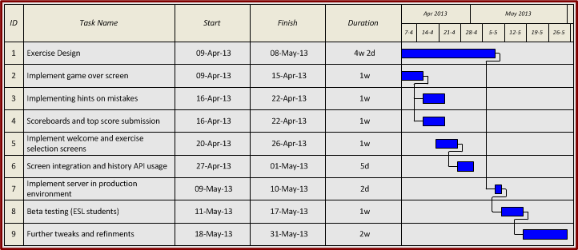
Work Plan

Slide 21
FIN
Good Luck !

